Slide 1

Stefan Bechtold | Sam Brannen | Johannes Link | Matthias Merdes | Marc Philipp | Christian SteinVersion
Latest Release: 5.1.0
Feb 18, 2018

Slide 2
Why New Version?
What’s New?
Big Picture
JUnit5 Overview
Demo
Extensions
References

Slide 3

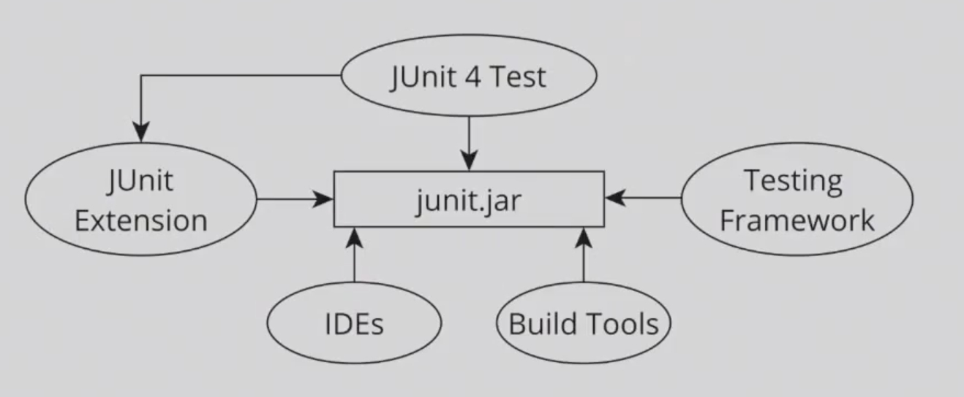
Released a decade ago
Big ball of mud – THE junit.jar
Only 1 runner per test class! SpringJunit4ClassRunner + Parametrized
Single rule cannot be used for method and class level
Top 20 Libraries Used by Github’s Most Popular Java Projects
Lot of room for improvement in terms of extensibility
Let’s not forget modern versions of JVM

Slide 4

What’s New?
JUnit Platform
JUnit Jupiter
JUnit Vintage
Revolutionary
Evolutionary
Necessary

Slide 5
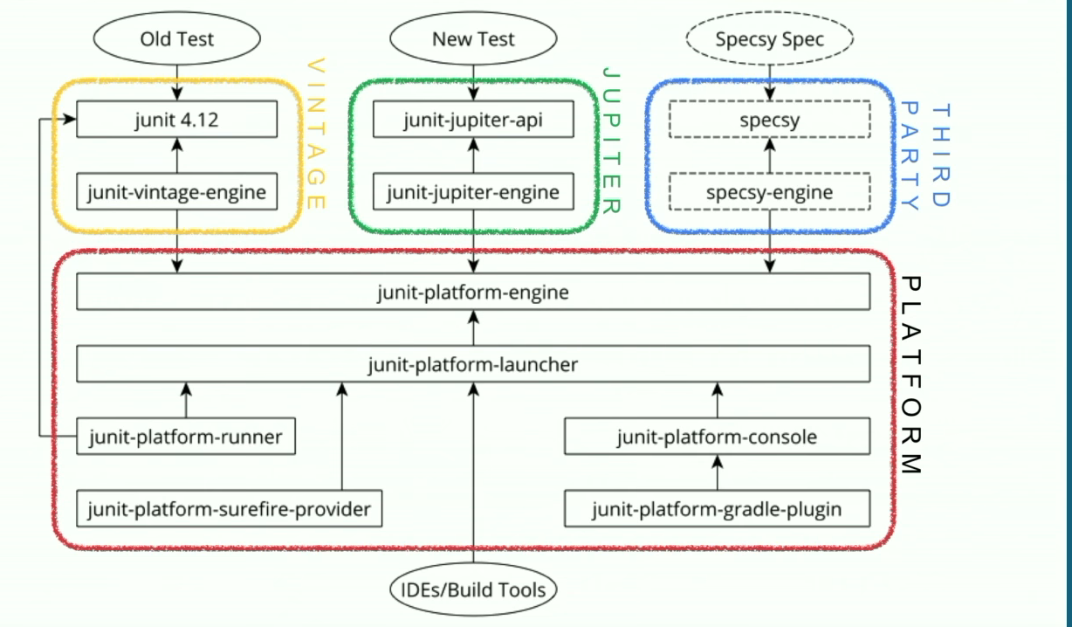
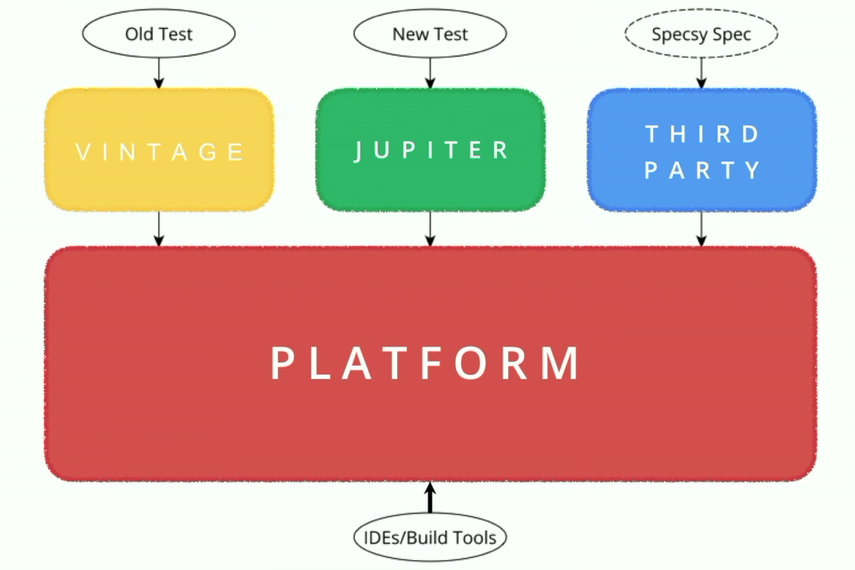
Big Picture

Slide 6

Modular
Powerful Extension Model
Modern
API Segregation: Decouple test execution/reporting from test definition
Write Tests - Jupiter API
Discover and Execute – Test Engine SPI
Test Execution by tools – Launcher API
Forward and Backward compatible

Slide 7


Slide 8
Extensions
Conditional Test Executions
EnabledOnOs
DisabledOnOs
EnabledOnJre
DisabledOnJre
EnabledIfSystemProperty
DisabledIfSystemProperty
EnabledIfEnvironmentVariable
DisabledIfEnvironmentVariable
EnabledIf
DisabledIf
General Purpose
TestInstancePostProcessor
ParameterResolver
TestTemplateInvocationContext-
Provider
Test LifeCycle Callbacks
BeforeAllCallback
BeforeEachCallback
BeforeTestExecutionCallback
TestExecutionExceptionHandler
AfterTestExecutionCallback
AfterEachCallback
AfterAllCallback

Slide 9
References
JUnit 5 User Guide
https://junit.org/junit5/docs/current/user-guide/index.pdf
JUnit 5: New Opportunities for Testing on the JVM
https://www.youtube.com/watch?v=-mIrA5cVfZ4
The New Testing Framework for Java and Platform for the JVM
https://www.youtube.com/watch?v=751gMXH-lEE
Junit 5 Sample pom.xml
https://github.com/junit-team/junit5-samples/blame/master/junit5-maven-consumer/pom.xml

